Slide 1


MAJOR Project
PRESENTED BY :-
NAME : BOMMANA SUDHARSHAN
MOBILE NUMBER : 6302123894
E-MAIL : sudharshanbommana@gmail.com
Linkdin : linkedin.com/in/bommana-sudharshan-54350622b

Slide 2
Project Name:- Cyber Security November Major Project
Problem Statement:-
1.Perform Scanning Module by using Nmap tool (Download from Internet) and scan kali linux and Windows7 machine and find the open/closed ports and services running on machine Hacker Machine : Windows 10 Victim machine : Kali Linux and Windows 7
2 Test the System Security by using metasploit Tool from kali linux and hack the windows 7 / windows10. Execute the commands to get the keystrokes / screenshots / Webcam and etc., Write a report on vulnerability issue along with screenshots how you performed and suggest th security patch to avoid these type of attacks Hacker Machine : Kali Linux Victim machine : Windows XP / Windows7
3. Use SET Tool and create a fake Gmail page and try to capture the credentials in command line and Hacker Machine : Kali Linux Victim machine : Windows XP / Windows 7 / Windows 10 4. Install Social Phish tool from GitHub and try to execute the tool for phishing page and perfrom in lab setup only 5. Perform SQL injection Manually on http://testphp.vulnweb.com Write a report along with screenshots and mention preventive steps to avoid SQL injections 6. Crack the password of windows machine by using ophcrack tool in virtual machine on windows 7 and try get the password, along with that mention the path of SAM file in windows and and explain about SAM file usage and how it can be cracked by tool. 7. Write an Article on cybersecurity and recent attacks which you came across in media and news and research on that news, and explain the any topic which you learned in this course and mention what you learned

Slide 3
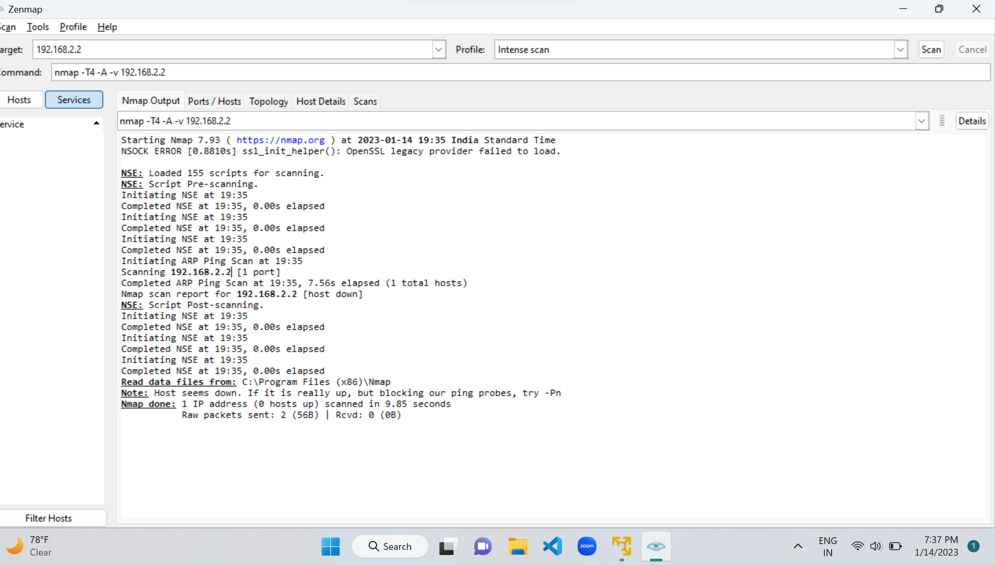
1.Perform Scanning Module by using Nmap tool (Download from Internet) and scan kali linux and Windows 7 machine and find the open/closed ports and services running on machine Hacker Machine : Windows 10 Victim machine : Kali Linux and Windows 7

Slide 4
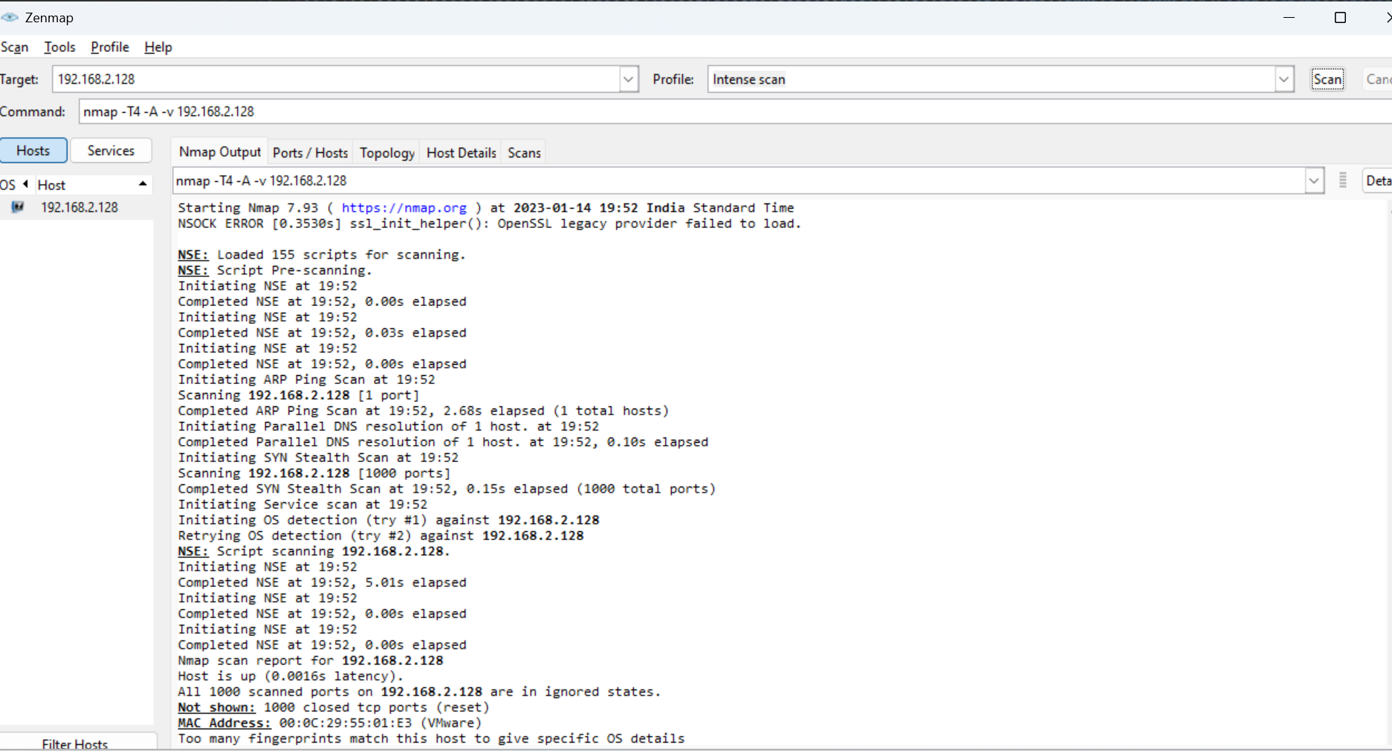

Slide 5
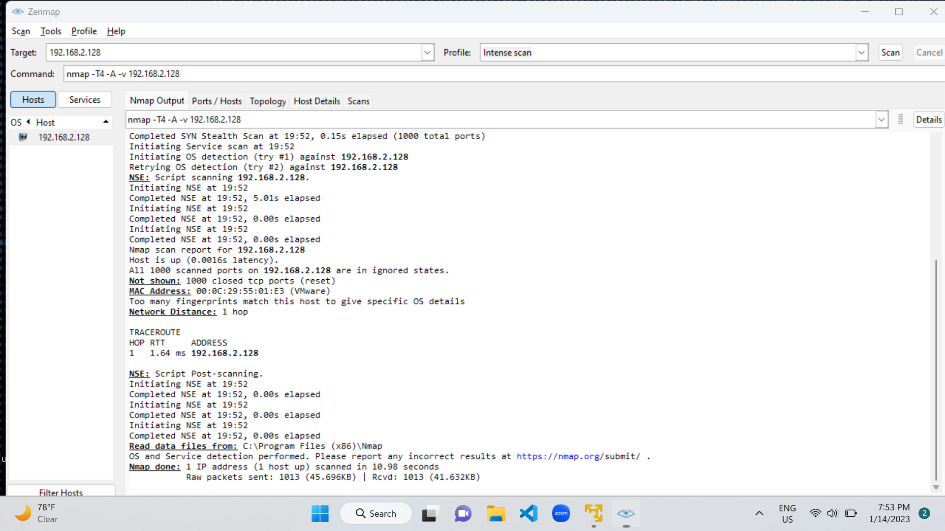

Slide 6
Result:-
The windows 11 showed a number of open ports on scanning the system for open ports through Intense scan module of the Nmap tool.
Scanning the kali Linux system first through the Nmap and Nmap -p command showed that there were no open ports.
The scanning on windows 7 machine showed 0 open ports.
Any open ports can be used by the Hacker or attacker to send Trojans at the particular open port.
It is also possible to perform DOS attacks on these open ports.
Also additional information such as the type of OS creation time becomes available through the Nmap tool scanning

Slide 7
Prevention of leaving any ports open:-
The following filters detect and/or block port scans and host sweeps.
1) 7000: TCP: Port Scan
2) 7001: UDP: Port Scan
3) 7002: TCP: Host Sweep
4) 7003: UDP: Host Sweep
5) 7004: ICMP: Host Sweep
7016: ICMPv6: Host Sweep
These filters ignore the following types of traffic:
blocked or trusted by a Traffic Management filter
trusted flow due to Trust as an Action
blocked or trusted by IP Reputation
matches an inspection-bypass rule
When a attacker try to port scan your server, first because of iptable attacker will not get any information which port is open. Second the Attacking IP address will be blacklisted for 24 Hour (You can change it in script) . Third , after that attacker will not able to open access anything for eg. even attacker will not see any website running on server via web browser, not able to ssh, telnet also. Means completely restricted.

Slide 8
2.Test the System Security by using metasploit Tool from kali linux and hack the windows 7 / windows10. Execute the commands to get the keystrokes / screenshots / Webcam and etc., Write a report on vulnerability issue along with screen shots how you performed and suggest the security patch to avoid these type of attacks Hacker Machine : Kali Linux Victim machine : Windows XP / Windows 7
REPORT WRITTING ON SYSTEM
HACKING USING METASPLOIT TOOL
reported BY
(BOMMANA SUDHARSHAN)
(15-01-23 SUNDAY )
The Metasploit framework is a very powerful tool which can be used by cybercriminals as well as ethical hackers to probe systematic vulnerabilities on networks and servers. Because it's an open-source framework, it can be easily customized and used with most operating systems .Metasploit facilitates ease while building a large penetration test of a network. For example, suppose we have to test any network having 200 systems. Rather than testing all the systems one-by-one, Metasploit can test the whole range automatically.

Slide 9
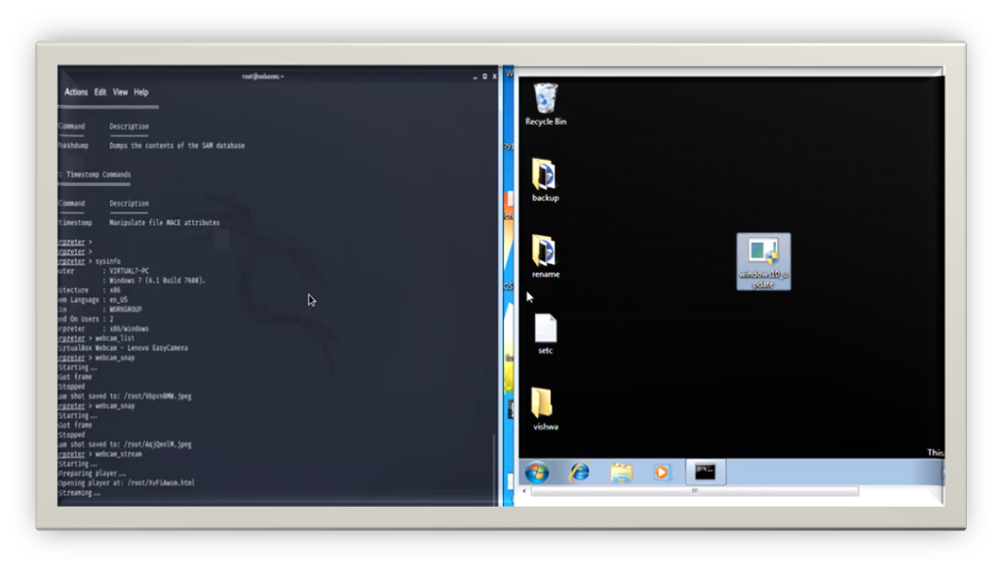

Slide 10
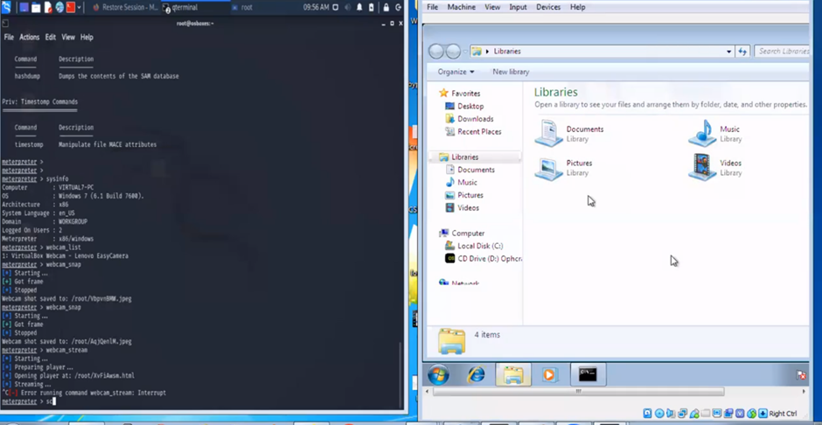

Slide 11
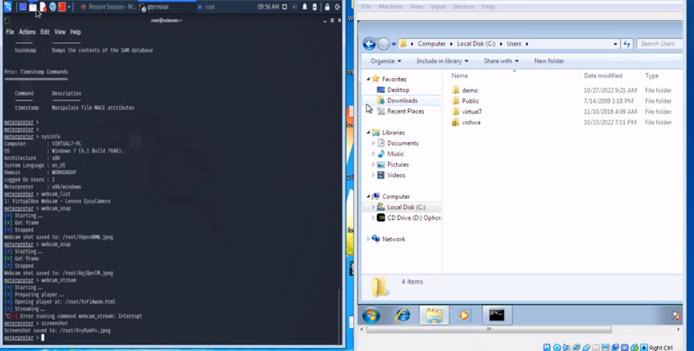

Slide 12
Ways to prevent Metasploit tool hacking:-
You would fight against a hacker using metasploit the same way you would fight against a hacker without metasploit. In fact, metasploit makes it easier for a corporation to defend its network against hackers as it makes the process of assessing security vulnerabilities simpler and more efficient. Additionally, a more sophisticated attacker will write their own exploits rather than relying on metasploit, since all of the exploits and payloads are well known and thus easy to detect.
To better answer your question, lets first look at how metasploit is used by both the hacker and the defensive security practitioner.
Metasploit is a penetration testing framework. As far as we are concerned, it contains known exploits and payloads to be used by defensive and offensive security practitioners (as well as more malevolent actors a.k.a hackers).
The goal of Metasploit for the malicious hacker is to simplify the exploitation process. Lets look at a well known vulnerability and how a hacker would go about exploiting this vulnerability with and without Metasploit. We will look at Eternal Blue (ms017-010). Eternal Blue is an SMB kernal pool corruption vulnerability that can result in remote code execution. To simplify what this means, a hacker can gain access to server or computer vulnerable to Eternal Blue.
Without metasploit, the attacker would have to first verify that the target computer is vulnerable. This would involve reconnaissance such as running various scans against the target server, checking for open ports and service versions that could indicate if the server is vulnerable or not. Then the attacker would develop or otherwise obtain an exploit that takes advantage of this vulnerability. After testing the exploit in an isolated lab environment (so the exploit doesnt fail and get him/here caught) the exploit is finally launched against the server. This process can be quite expensive in time to develop the exploit and knowledge required to do so. Additionally, the only guarantee the exploit will work is based on the developers confidence.
With metasploit, the attacker can use built in tools used to determine if a system is vulnerable. Then he would load up a module implementing the Eternal Blue exploit, load a payload such as a reverse shell and execute the attack against the target. All the hard work is done and with a few keyboard strokes, the system is owned.
The defensive security practitioner (the individual or team responsible for defending the network) has a similar view of metasploit. If the defender wants to determine if his systems are vulnerable to Eternal Blue, one method to take is to pretend to be an attacker and see if he can exploit any of his systems. Just like the attacker, he would have to develop and execute an exploit. With the metasploit framework, the process is simplified, making it easier for him to test his networks exposure levels and patch any vulnerable systems.

Slide 13
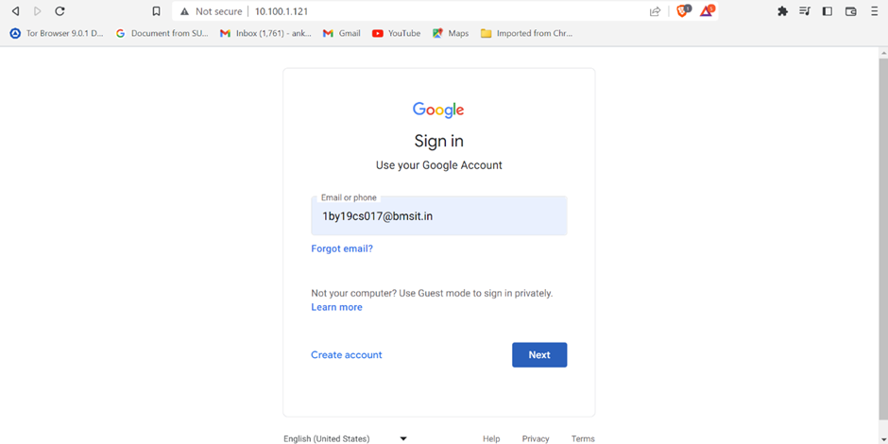
3.Use SET Tool and create a fake Gmail page and try to capture the credentials in command line and Hacker Machine : Kali Linux Victim machine : Windows XP / Windows7 / Windows 10

Slide 14
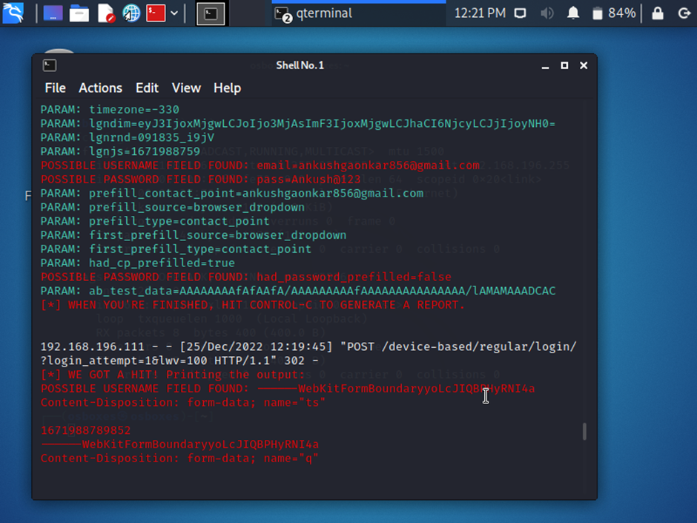

Slide 15
Steps To prevent Social Engineering Attacks:-
1.Delete any request for personal information or passwords. Nobody should be contacting you for your personal information via email unsolicitedly. If you get asked for it, it’s a scam.
2. Reject requests for help or offers of help. Social engineers can and will either request your help with information or offer to help you (i.e posing as tech support). If you did not request any assistance from the sender, consider any requests or offers a scam. Do your own research about the sender before committing to sending them anything.
3. Set your spam filters to high. Your email software has spam filters. Check your settings, and set them to high to avoid risky messages flooding into your inbox. Just remember to check them periodically as it is possible legitimate messages could be trapped there from time to time.
4. Secure your devices. Install, maintain and update regularly your anti-virus software, firewalls, and email filters. Set your automatic updates on if you can, and only access secured websites. Consider VPN.
5. Always be mindful of risks. Double check, triple check any request you get for the correct information. Look out for cybersecurity news to take swift actions if you are affected by a recent breach. I recommend subscribing to a couple of morning newsletter to keep you up to date with the latest in InfoSec like Cyware or BetterCloud Monitor. If you are a podcast person, Decrypted by Bloomberg, DIY Cyber Guy and Reply All offer easy to digest information and news that’s very user-friendly.

Slide 16

Some Quick Tips to Remember:-
Think before you click.
Research the sources.
Email spoofing is ubiquitous.
Don’t download files you don’t know.
Offers and prizes are fake.

Slide 17
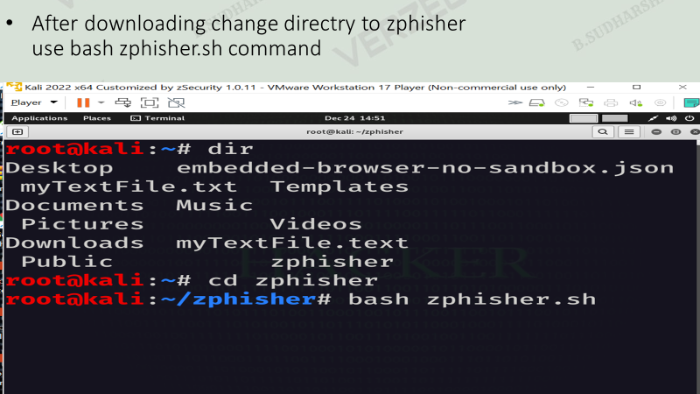
4.Install Social Phish tool from GitHub and try to execute the tool for phishing page and perfrom in lab setup only

Slide 18
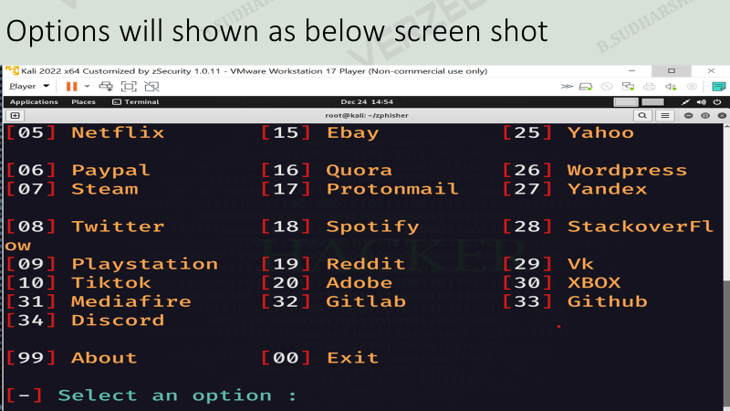

Slide 19
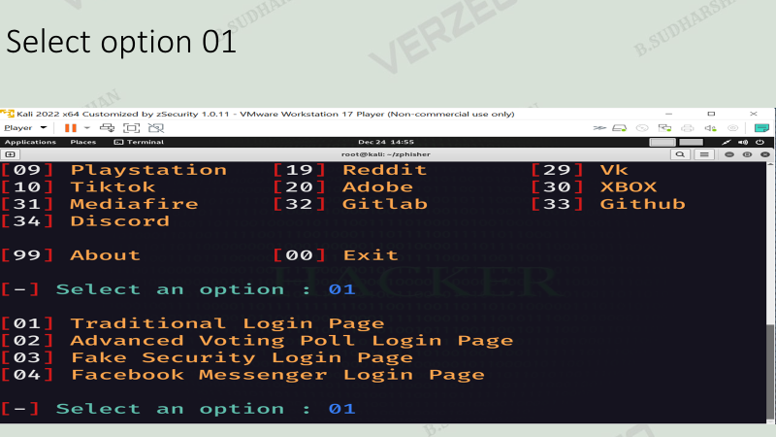

Slide 20
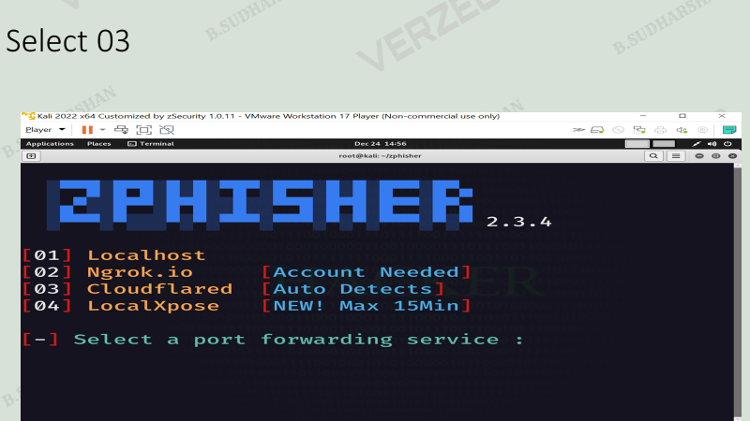

Slide 21
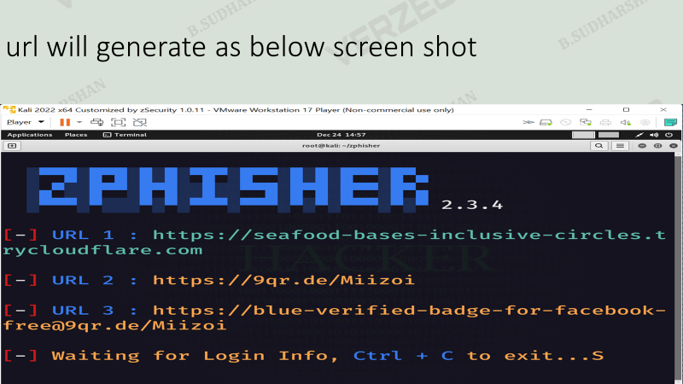

Slide 22
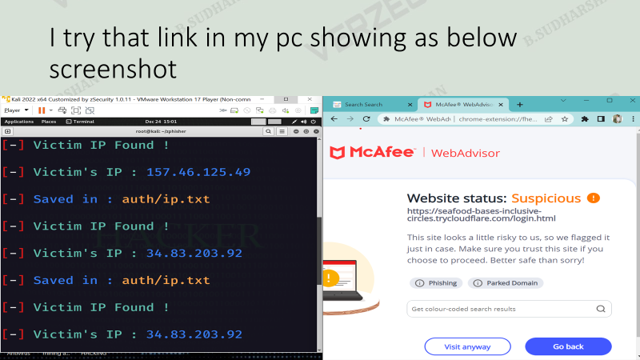

Slide 23
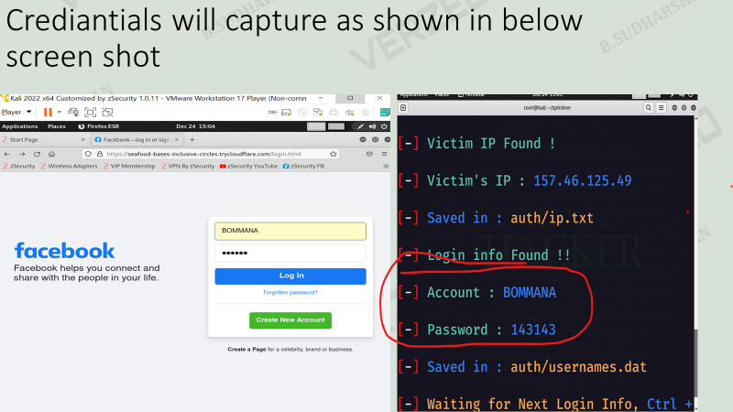

Slide 24
5.Perform SQL injection Manually onhttp://testphp.vulnweb.com Write a report along with screenshots and mention preventive steps to avoid SQL injections
REPORT WRITING ON SQL INJECTION
REPORTED BY
(BOMMANA SUDHARSHAN)
(14-01-23 , Saturday)
SQL injection (SQLi) is a web security vulnerability that allows an attacker to interfere with the queries that an application makes to its database. It generally allows an attacker to view data that they are not normally able to retrieve. This might include data belonging to other users, or any other data that the application itself is able to access. In many cases, an attacker can modify or delete this data, causing persistent changes to the application's content or behavior.
Here I used SQL injection on http://testphp.vulnweb.com website .
There are two type of websites:-
Static website and Dynamic website
These contains admin panels ------update the data / delete / add /etc
We can try to login into admin login without knowing user name and possword

Slide 25
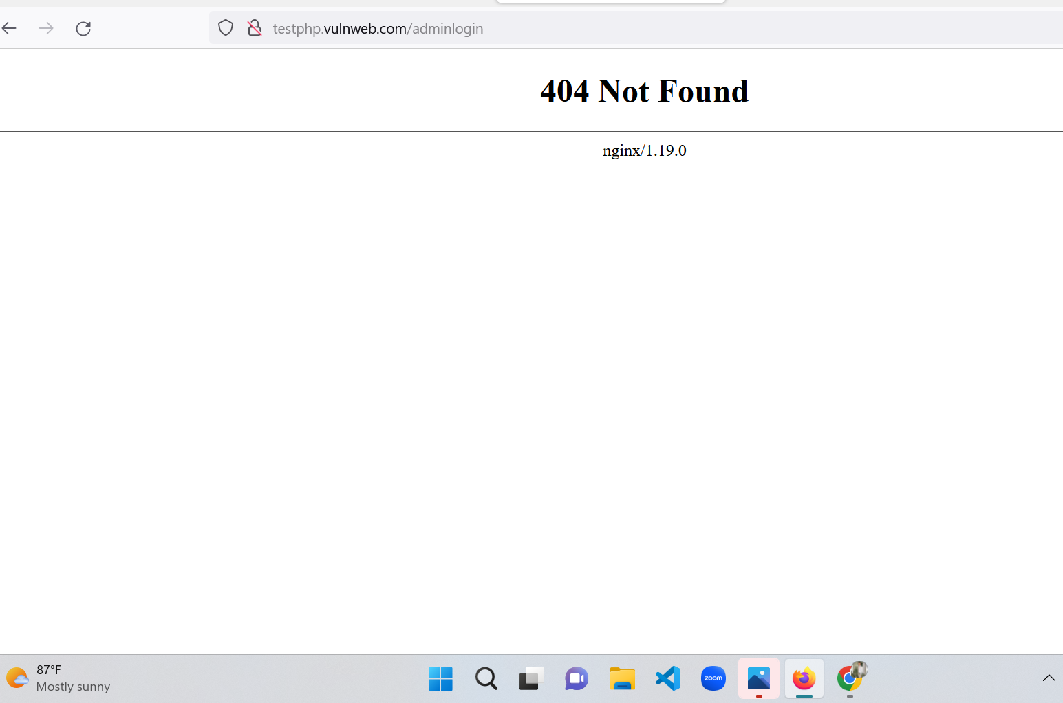
Logic behind the Database
User id pwd Result
T T T(successful login)
T F F(unsuccessful login)
F T F(unsuccessful login)
Let try with http://testphp.vulnweb.com/adminlogin
Some target admin pages
www.xyz.com/adminlogin
www.xyz.com/Admin_login
www.xyz.com/login.php
www.xyz.com/login.php / .aspx
www.xyz.com/sign_in
www.xyz.com/Admin_Login

Slide 26
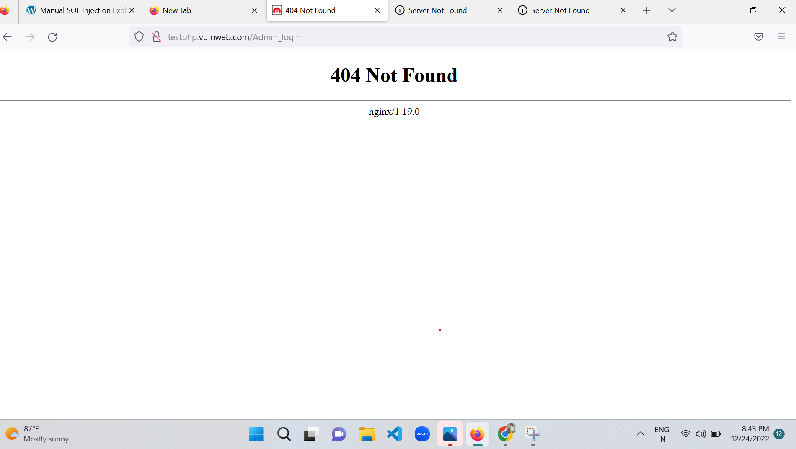
Let try with http://testphp.vulnweb.comAdmin_login

Slide 27
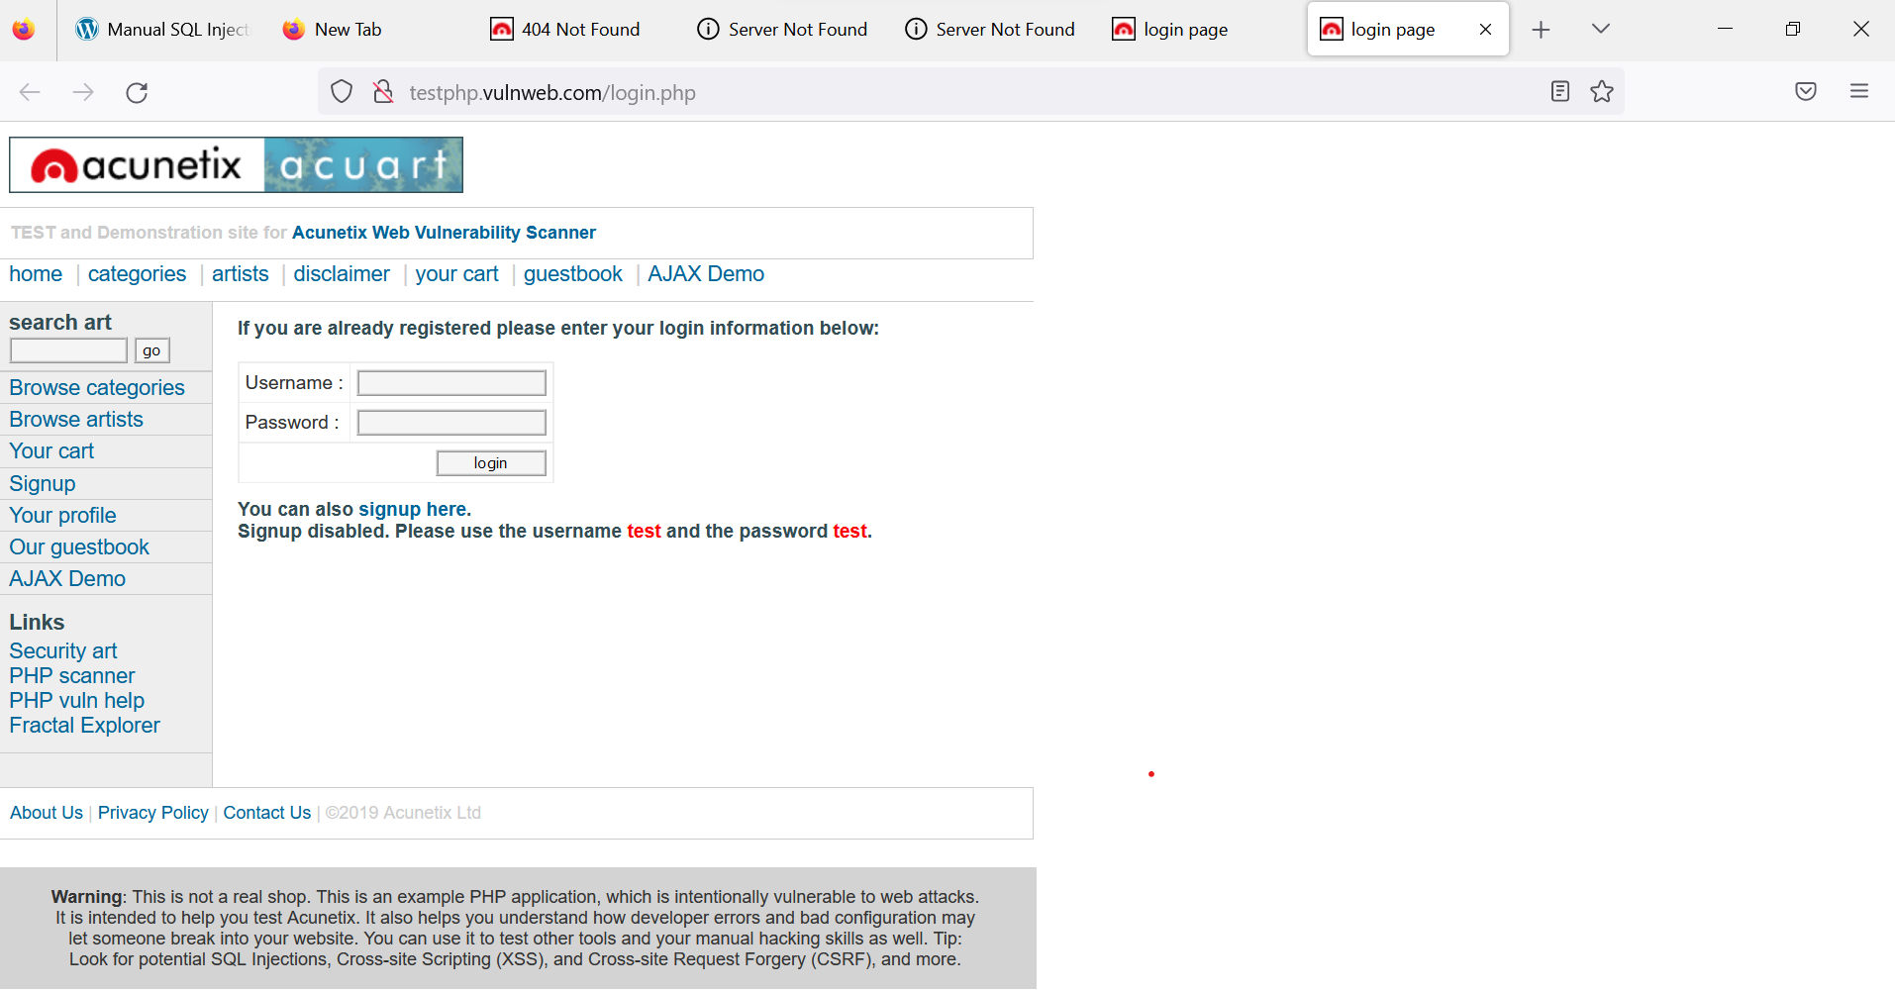
Let try with http://testphp.vulnweb.com/login.php successfully I entered into login page

Slide 28
Let try with some defalt usr id &pwd
User id | possword
admin | admin
admin | Admin@123
admin | admin@123
admin | Administrator@123
root | root@0000
admin | Xyz.com@123

Slide 29
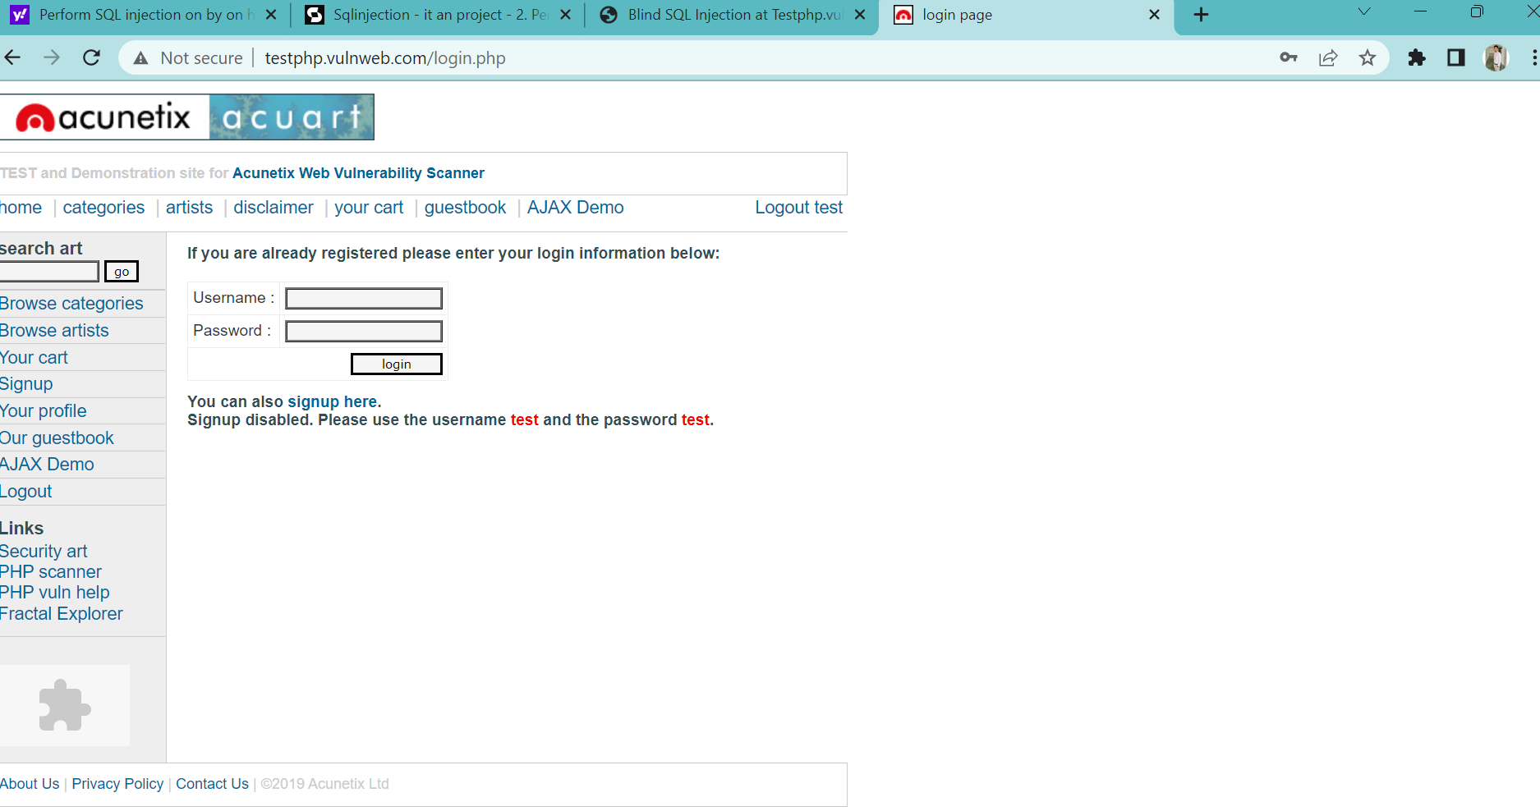
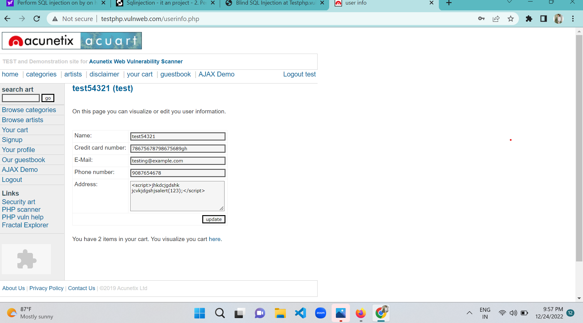
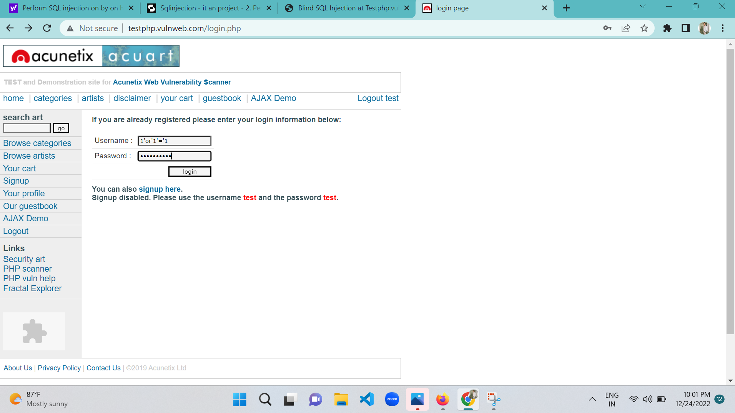

Slide 30
steps to avoid SQL injections
Continuous Scanning and Penetration Testing
Restrict Privileges
Use Query Parameters
Instant Protection
The only sure way to prevent SQL Injection attacks is input validation and parametrized queries including prepared statements. The application code should never use the input directly. The developer must sanitize all input, not only web form inputs such as login forms.
Best Practices to Prevent SQL Injection Attacks
Do not rely on client-side input validation.
Use a database user with restricted privileges.
Use prepared statements and query parameterization.
Scan your code for SQL injection vulnerabilities.
Use an ORM layer.
Don't rely on blocklisting.
Perform input validation.

Slide 31
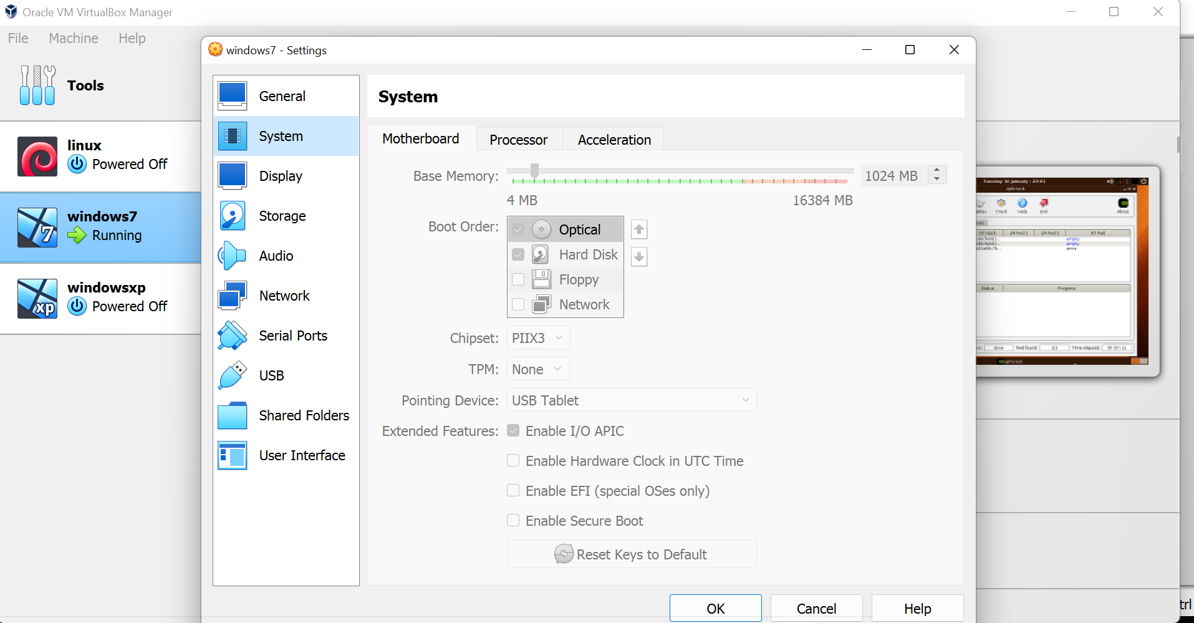
6.Crack the password of windows machine by using ophcrack tool in virtual machine on windows 7 and try get the password, along with that mention the path of SAM file in windows and and explain about SAM file usage and how it can be cracked by tool.

Slide 32
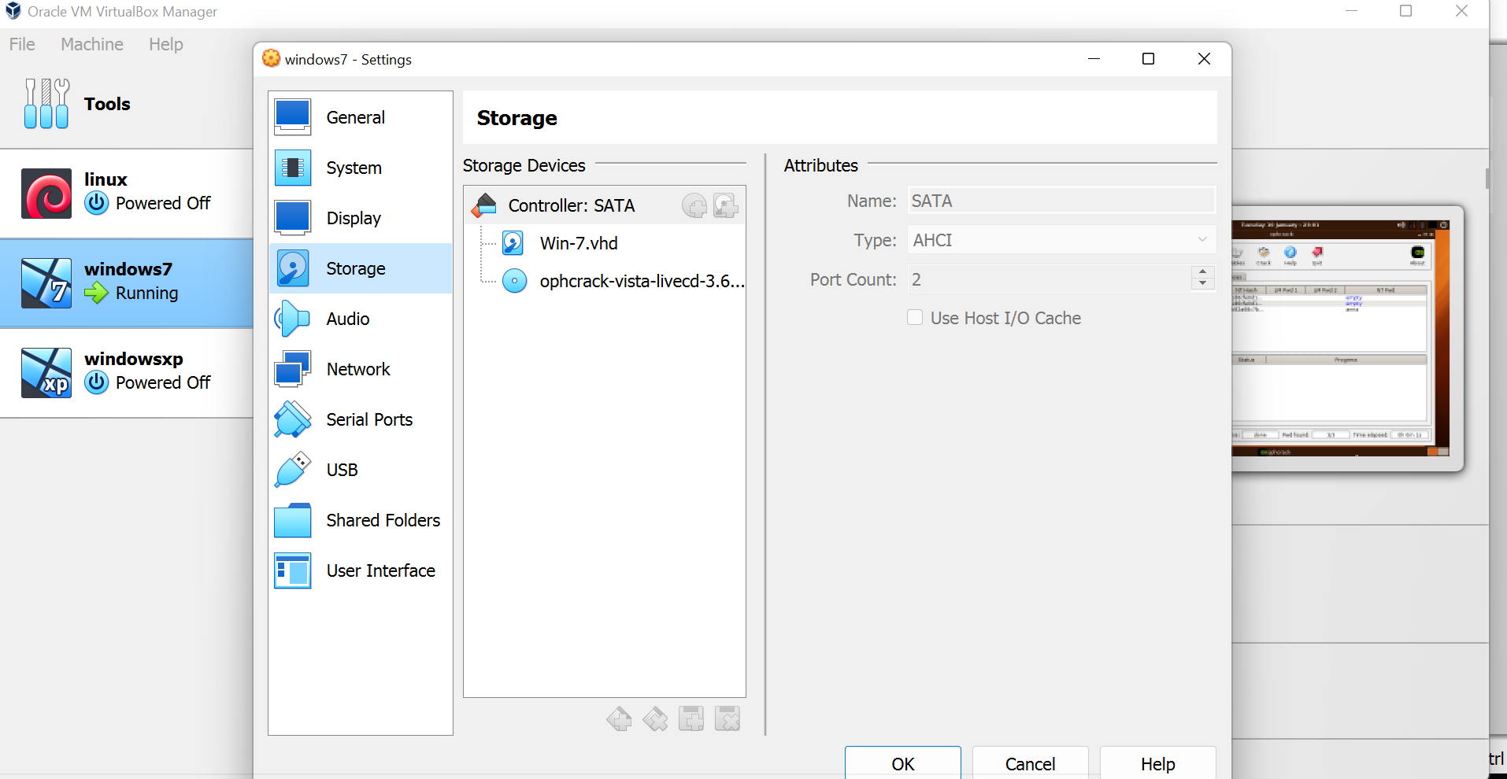

Slide 33
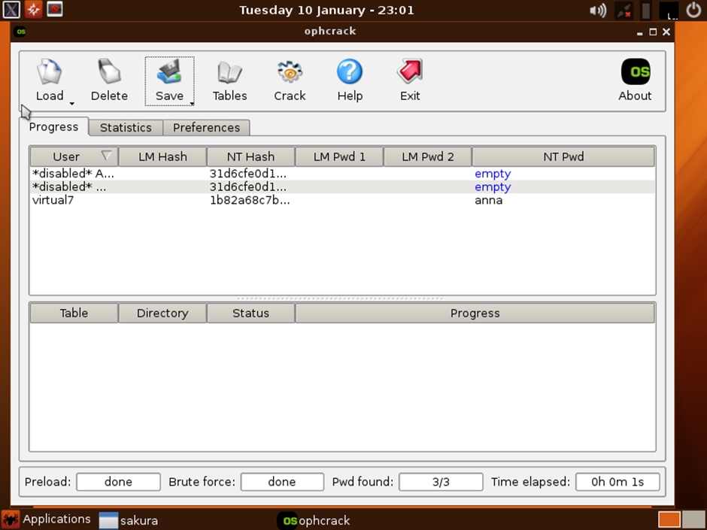

Slide 34
Ways to prevent Ophcrack tool hacking:
(1) Password policies Password policies are a front line of defense. They are typically a set of rules intended to improve security by motivating or compelling users to create and maintain dependable, safe passwords. Password policies govern password lifecycle events, such as authentication, periodic resets, and expiration. Although some password policies are advisory and outline best practices for users, most sites require users to adhere to the policy using programmatic rules. User frustration can arise if users are required to spend time attempting to create passwords that meet unfamiliar criteria. Having a password policy can help mitigate user frustration by providing guidelines and certainty. The following are examples of password policies:

Slide 35
Requiring longer passwords. Longer passwords and passphrases have been shown to substantially improve security. However, it’s still essential to avoid longer passwords that have been previously compromised or regularly appear in cracking dictionaries.
• Do not use personal details. This password policy encourages users to create passwords with no link to the user’s personal information. As explained earlier, most users build passwords using personal details, such as hobbies, nicknames, names of pets or family members, etc. If a hacker has access to personal details about a particular user (such as through social media), they will try password combinations using this information. At a minimum, passwords should be checked screened to make sure they don’t include basic information like the user’s name or login information.
• Use different passwords for different accounts. Password policies should require users to differentiate security from convenience and disallow users from using the same password for all of their accounts. Password sharing between users – even those who might work in the same department or who may use the same equipment – should have distinct passwords.
• Adopt passphrases as a standard. Some password policies require users to create a passphrase as opposed to a password. While passphrases serve the same purpose, they are usually harder to crack due to their length. An effective passphrase should include numbers and symbols as well as letters. Users may remember passphrases more easily than passwords.

Slide 36
Discourage sharing. Password policies should specify that passwords are meant to be personal and should not be shared between users. Use the second factor. Another password policy is the adoption of two-factor authentication (2FA.) 2FA requires a user to present two pieces of evidence before they can log in, which is typically a password and a temporary code delivered to a cellphone, an email or other method.
(2) Passwordscreening
One of the best ways to prevent dictionary attacks is to screen them against known lists of dictionary passwords and compromised passwords. Compromised password screens collect compromised data from the internet and Dark Web sources and then determines if the password a user is trying to create has been compromised. Password screening tools work by checking a partial hash of username and password at login, password setup, and reset. It can also be beneficial to consumer sites and e-commerce companies to detect and protect them from fraudsters who use previously compromised credentials.

Slide 37
7.Write an Article on cybersecurity and recent attacks which you came across in media and news and research on that news, and explain the any topic which you learned in this course and mention what you learned
Finnish Parliament Attack
In August 2022, the Finnish parliament's website experienced a DDoS attack while the parliament was in session. This denial-of-service attack may be part of a coordinated campaign by Russian state-sponsored hackers to disrupt the Finnish government’s websites in retaliation for the application to join NATO. A DDoS attack temporarily blocks access to a website but does not cause permanent destruction.
Ukrainian State Nuclear Power Company Attack
The Russian “hacktivist” group called the People’s Cyber Army engaged 7.25 million bots in August 2022 in a bot attack to take the Energoatom website down. It used a flood of garbage web traffic and webpage requests. A disruption of online services lasted for a few hours, but no permanent negative impact remained. The attack was part of a Russian psyops campaign to create fear of a nuclear disaster and terrorize Europeans.

Slide 38
Greek Natural Gas Distributor Attack
Greek national gas distributor DESFA reported an incidence of a cyber attack in August 2022. The attack impacted part of the company’s IT infrastructure and caused a data leak. The ransomware operation of cybercriminals called Ragnar Locker is holding the stolen data hostage. They demand ransom not to expose sensitive data. The company refused to make a payment.
South Staffordshire Water Company Attack
In August 2022, the South Staffordshire Water Company reported an attack that caused a network disruption in its internal corporate network and a data loss. A cybercriminal ransomware group threatened to tamper with the water supplied by the company. The company disputed this claim. The criminals demanded payment to not release sensitive files and explain how the network breach happened.

Slide 39
Montenegro Government Attack
The government of Montenegro's digital IT infrastructure reported an unprecedented cyberattack in August 2022. No data breach occurred. However, certain governmental services and telecommunications experienced disruption, including border crossings and airport operations. The state-owned utility company, EPCG, switched to manual operations as a precautionary measure.
Estonian Government Attack
A DDoS attack disrupted many Estonian government websites for several hours in April 2022. The attack targeted websites for the president, the Ministry of Foreign Affairs, the Police and Border Guard, the identification card webpage, and the state services digital portal. Estonia’s condemnation of the Russian war on Ukraine makes the country a target for Russian hackers.

Slide 40
Islamic Culture and Communication Organization Attack
The Iranian Islamic Culture and Communication Organization (ICCO) experienced a severe attack in July 2022. Six ICCO websites went down, and 15 others changed to photos of Massoud Rajaivi, the Iranian Resistance leader. Additionally, there was data destruction on 44 servers and hundreds of computers. The ICCO also lost 35 databases with highly-confidential information about money laundering, spies, and terrorists living abroad.
Belgian Government and Military Attack
In July 2022, the Belgian government announced that three Chinese hacker groups, part of the known Chinese Advanced Persistent Threat actors, attacked Belgian public services and military defense forces. The Chinese government-sponsored attackers steal trade secrets and intelligence information. The Soft Cell Chinese group recently launched a new remote access trojan (RAT) malware in June 2022

Slide 41
ProxyLogon Cyberattack
One of the most damaging recent cyberattacks was a Microsoft Exchange server compromise that resulted in several zero-day vulnerabilities. The vulnerabilities, known as ProxyLogon and initially launched by the Hafnium hacking group, were first spotted by Microsoft in January and patched in March. However, more groups joined Hafnium in attacking unpatched systems, resulting in thousands of organizations being compromised.
MeetMindful Cybersecurity Breach
Dating app MeetMindful suffered a cybersecurity attack in January 2021, resulting in data of more than 2 million users being stolen and leaked. The hacking group behind the event managed to steal information like users’ full names and Facebook account tokens

Slide 42
Tether Attack
In March 2021, cyber criminals threatened to leak documents from the Tether cryptocurrency. The attackers claimed the data would “harm the Bitcoin ecosystem” and demanded a settlement fee of around 500 Bitcoin ($24 million), but Tether refused to pay.
CNA Financial Breach
A ransomware attack on insurance firm CNA Financial left employees locked out of their systems and blocked from accessing corporate resources. The attack in March 2021 also involved company data being stolen, which led CNA Financial to reportedly pay the $40 million settlement fee.
Facebook Cyberattack
Data of more than 530 million Facebook users, including their names, Facebook IDs, dates of birth, and relationship status, was published online in April 2021. Facebook, now Meta, said the information was obtained through scraping in 2019.

Slide 43
Colonial Pipeline Attack
The growing threat that advanced cybersecurity attacks pose to the world was highlighted by the Colonial Pipeline attack in May 2021. The fuel pipeline operator suffered a ransomware attack launched by the DarkSide hacking group, which led to fuel disruption and mass panic buying across the U.S.
Omiai Cyberattack
An unauthorized entry cyberattack in May 2021 resulted in the exposure of 1.7 million users of the Japanese dating app Omiai.
Audi and Volkswagen Cybersecurity Breach
In June 2021, Audi and Volkswagen revealed a data breach had affected more than 3.3 million customers and prospective buyers, who were primarily U.S.-based. The breach was blamed on an associated vendor, which was purportedly responsible for exposing the data between August 2019 and May 2021.
Guntrader.uk Cyberattack
The United Kingdom’s trading website for guns and shooting equipment revealed that records of 100,000 gun owners had been stolen and published online in July 2021. Gun ownership is strictly controlled in the U.K., so the data breach of customers’ names and addresses caused significant privacy and safety concerns.

Slide 44
T-Mobile Attack
In August 2021, telecoms firm T-Mobile suffered a cybersecurity breach that led to the data of around 50 million existing customers and prospects being stolen. The data, which included customer addresses, drivers' licenses, and social security numbers, was stolen by a 21-year-old, who claimed to have obtained around 106GB of information.
Poly Network Breach
An attack on Poly Network in August 2021 proved that cybersecurity breaches on cryptocurrency firms are on the rise. The blockchain firm revealed an Ethereum smart contract hack resulted in cyber criminals stealing cryptocurrency worth more than $600 million.
AP-HP Attack
Cybersecurity attacks on medical organizations and healthcare firms are also increasing. As a result of the hack on AP-HP, a Paris public hospital system, in September 2021, cyber criminals stole personal data belonging to around 1.4 million people who were tested for COVID-19 in 2020.
Cream Finance Breach
Cream Finance, a decentralized finance firm, suffered a vulnerability in its project’s market system. The hack, which was revealed in September 2021, caused losses worth $34 million.

Slide 45
Concepts learned within the given course:
Hacking :
Hacker is the one who is smart enough to steal the information such as business data, personal data, financial information, credit card information, username and password from the system he is unauthorized to get this information by taking unauthorized control over that system using different tools and techniques. These vulnerability or weakness can be used by the hacker to commit crime or to take advantages of remote machine.
Information Security is that the practice of protecting information from unauthorized access, usage, disclosure, disruption, modification, inspection, copying or destruction ➢ Information can be defined as the "Processed Data" which contains some meaningful message ➢ Information does not depend on language; it can be a chain of symbols, mental stimuli of living beings ➢ The meaning of information depends on time, place and situation. As per the time and situation information may vary ➢ Information security techniques can be defined as the ways and means used to secure our personal or private information from being hacked or misused.

Slide 46
Ethical Hacking : Ethical Hacking involves in use of hacking tools, tricks and techniques to identify vulnerabilities to ensure system security. It is also called as penetration testing Ethical
Hacker : An ethical hacker is a expert in cybersecurity and who attacks a security system on behalf of its owners and seeking vulnerabilities that a malicious hacker could exploit.
Phases of Hacking:
Foot printing: Reconnaissance/Information Gathering refers to gathering Information about the Target. This was the first step of Hacking and the aim is to gather as much as information Target.
Scanning: Scanning refers to the pre-attack phase when the Hacker scans the Network or Website using in a general manner or using specific information gathered during the first step of Reconnaissance. This is an Active State of Gathering Information.

Slide 47
Target Information: OS of the Target Open Port and Services Vulnerable Applications
Gaining Access: Gaining Access refers to the Attack stage. In this Step, the Hacker will launch an Attack on the System, on the Basis of the Information Gathered during the First 2 Steps, of Reconnaissance and Scanning. Maintaining Access: Maintaining Access refers to a stage which is Post-Exploitation or Post-Attack. This is done once the Hacker “owns” the System. In order to Maintain Access to the Hacked system and control it remotely. Clearing Tracks: Covering Tracks refers to actions performed by a Hacker, Post-Exploitation, which helps is increasing the Time for which the System Compromise goes un-detected and similarly, the attacker does not get traced back.

Slide 48


